Slide 1

KNN Imputer Algorithm
Machine Learning

Slide 2
 | Friends | HIMYM | GOT | Suits | Breaking Bad
0 | 80 | 30 | 7 | 14 | 27
1 | 44 | -- | 10 | 0 | 29
2 | -- | 85 | 25 | 5 | 88
3 | 50 | 70 | 74 | 9 | 49
4 | 29 | 54 | 49 | 20 | --

Slide 3
 | Friends | HIMYM | GOT | Suits | Breaking Bad
0 | 80 | 30 | 7 | 14 | 27
1 | 44 | -- | 10 | 0 | 29
2 | -- | 85 | 25 | 5 | 88
3 | 50 | 70 | 74 | 9 | 49
4 | 29 | 54 | 49 | 20 | --
Step 1: Choose a missing value to fill.

Slide 4
 | Friends | HIMYM | GOT | Suits | Breaking Bad
0 | 80 | 30 | 7 | 14 | 27
1 | 44 | -- | 10 | 0 | 29
2 | -- | 85 | 25 | 5 | 88
3 | 50 | 70 | 74 | 9 | 49
4 | 29 | 54 | 49 | 20 | --
Step 1: Choose a missing value to fill.
Step 2: Select the other values in that row.

Slide 5
 | Friends | HIMYM | GOT | Suits | Breaking Bad
0 | 80 | 30 | 7 | 14 | 27
1 | 44 | -- | 10 | 0 | 29
2 | -- | 85 | 25 | 5 | 88
3 | 50 | 70 | 74 | 9 | 49
4 | 29 | 54 | 49 | 20 | --
Step 1: Choose a missing value to fill.
Step 2: Select the other values in that row.
Step 3: Choose the number of neighbors. We set neighbors=2 here.

Slide 6
 | Friends | HIMYM | GOT | Suits | Breaking Bad
0 | 80 | 30 | 7 | 14 | 27
1 | 44 | -- | 10 | 0 | 29
2 | -- | 85 | 25 | 5 | 88
3 | 50 | 70 | 74 | 9 | 49
4 | 29 | 54 | 49 | 20 | --
Step 1: Choose a missing value to fill.
Step 2: Select the other values in that row.
Step 3: Choose the number of neighbors. We set neighbors=2 here.
Step 4: Calculate nan_euclidian distance from all the other corresponding row elements
(green vs one yellow at a time)
So in total 4 calculations, from which we’ll select the smallest two.

Slide 7
 | Friends | HIMYM | GOT | Suits | Breaking Bad
0 | 80 | 30 | 7 | 14 | 27
1 | 44 | -- | 10 | 0 | 29
2 | -- | 85 | 25 | 5 | 88
3 | 50 | 70 | 74 | 9 | 49
4 | 29 | 54 | 49 | 20 | --
Calculating the nan_euclidean distances:
dist(x,y) = sqrt(weight * sq. distance from present coordinates)
where,
weight = Total # of coordinates / # of present coordinates

Slide 8
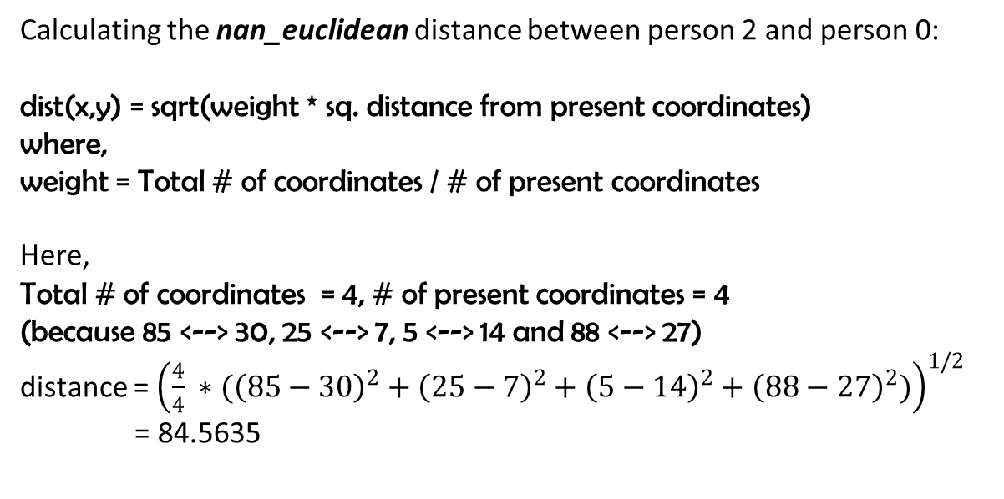
 | Friends | HIMYM | GOT | Suits | Breaking Bad
0 | 80 | 30 | 7 | 14 | 27
1 | 44 | -- | 10 | 0 | 29
2 | -- | 85 | 25 | 5 | 88
3 | 50 | 70 | 74 | 9 | 49
4 | 29 | 54 | 49 | 20 | --
Calculating the nan_euclidean distance between person 2 and person 0:
dist(x,y) = sqrt(weight * sq. distance from present coordinates)
where,
weight = Total # of coordinates / # of present coordinates
Here,
Total # of coordinates = 4, # of present coordinates = 4
(because 85 <--> 30, 25 <--> 7, 5 <--> 14 and 88 <--> 27)
distance = ${\left(\frac{4}{4} ∗({\left(85−30\right)}^{2}+{\left(25−7\right)}^{2}+{\left(5−14\right)}^{2}+{\left(88−27\right)}^{2})\right)}^{1/2}$
= 84.5635

Slide 9
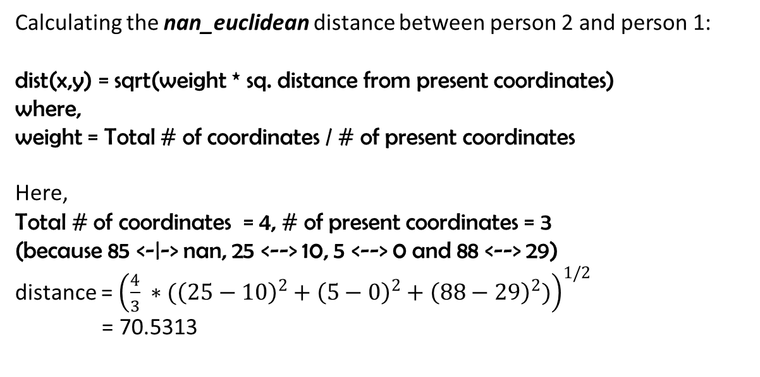
 | Friends | HIMYM | GOT | Suits | Breaking Bad
0 | 80 | 30 | 7 | 14 | 27
1 | 44 | -- | 10 | 0 | 29
2 | -- | 85 | 25 | 5 | 88
3 | 50 | 70 | 74 | 9 | 49
4 | 29 | 54 | 49 | 20 | --
Calculating the nan_euclidean distance between person 2 and person 1:
dist(x,y) = sqrt(weight * sq. distance from present coordinates)
where,
weight = Total # of coordinates / # of present coordinates
Here,
Total # of coordinates = 4, # of present coordinates = 3
(because 85 <-|-> nan, 25 <--> 10, 5 <--> 0 and 88 <--> 29)
distance = ${\left(\frac{4}{3} ∗({\left(25−10\right)}^{2}+{\left(5−0\right)}^{2}+{\left(88−29\right)}^{2})\right)}^{1/2}$
= 70.5313

Slide 10
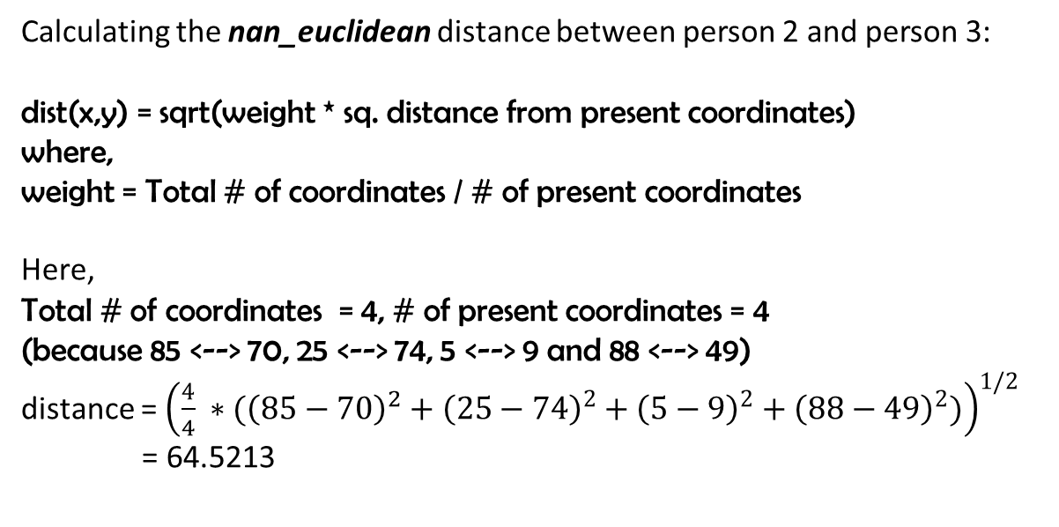
 | Friends | HIMYM | GOT | Suits | Breaking Bad
0 | 80 | 30 | 7 | 14 | 27
1 | 44 | -- | 10 | 0 | 29
2 | -- | 85 | 25 | 5 | 88
3 | 50 | 70 | 74 | 9 | 49
4 | 29 | 54 | 49 | 20 | --
Calculating the nan_euclidean distance between person 2 and person 3:
dist(x,y) = sqrt(weight * sq. distance from present coordinates)
where,
weight = Total # of coordinates / # of present coordinates
Here,
Total # of coordinates = 4, # of present coordinates = 4
(because 85 <--> 70, 25 <--> 74, 5 <--> 9 and 88 <--> 49)
distance = ${\left(\frac{4}{4} ∗({{\left(85−70\right)}^{2}+\left(25−74\right)}^{2}+{\left(5−9\right)}^{2}+{\left(88−49\right)}^{2})\right)}^{1/2}$
= 64.5213

Slide 11
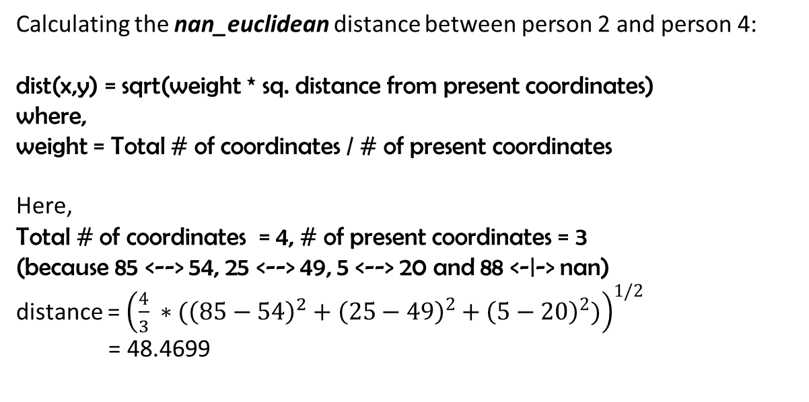
 | Friends | HIMYM | GOT | Suits | Breaking Bad
0 | 80 | 30 | 7 | 14 | 27
1 | 44 | -- | 10 | 0 | 29
2 | -- | 85 | 25 | 5 | 88
3 | 50 | 70 | 74 | 9 | 49
4 | 29 | 54 | 49 | 20 | --
Calculating the nan_euclidean distance between person 2 and person 4:
dist(x,y) = sqrt(weight * sq. distance from present coordinates)
where,
weight = Total # of coordinates / # of present coordinates
Here,
Total # of coordinates = 4, # of present coordinates = 3
(because 85 <--> 54, 25 <--> 49, 5 <--> 20 and 88 <-|-> nan)
distance = ${\left(\frac{4}{3} ∗({{\left(85−54\right)}^{2}+\left(25−49\right)}^{2}+{\left(5−20\right)}^{2})\right)}^{1/2}$
= 48.4699

Slide 12
 | Friends | HIMYM | GOT | Suits | Breaking Bad
0 | 80 | 30 | 7 | 14 | 27
1 | 44 | -- | 10 | 0 | 29
2 | 39.5 | 85 | 25 | 5 | 88
3 | 50 | 70 | 74 | 9 | 49
4 | 29 | 54 | 49 | 20 | --
Step 1: Choose a missing value to fill.
Step 2: Select the other values in that row.
Step 3: Choose the number of neighbors. We set neighbors=2 here.
Step 4: Calculate nan_euclidian distance from all the other corresponding row elements
Step 5: Choose smallest two distances.
Here the smallest two are 48.4699 and 64.5213. Hence we conclude that persons 3 and 4 are most likely similar to person 2. Hence we take mean of ‘Friends’ column of persons 3 and 4, and assign it to Person 2’s missing Friends score = (50 + 29) / 2 = 39.5

